Slide 1
welcome to
COMP 2691
Intermediate Windows Application Development in .NET
Week 5
GUI Concepts (Part Two)
Amir Ahani, M.Sc. + MBA
Microsoft Certified Solution Developer (MCSD .NET)
Microsoft Certified Database Administrator (MCDBA)
Email: amirahani@gmail.com
<number> of 17
Notes:
COMP2690 Windows Application Development with C#

Slide 2
Today…
Windows Forms Controls
  The ImageList Control
  The TreeView Control
  The ListView Control
  The TabControl Control
  The DataGrid Control
  The GridView Control
  The ToolStrip Control
  The MenuStrip Control
  The StatusStrip Control
  The FlowLayoutPanel Control
<number> of 17
Notes:
COMP2690 Windows Application Development with C#

Slide 3

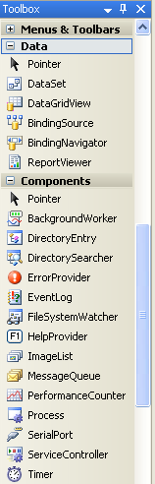
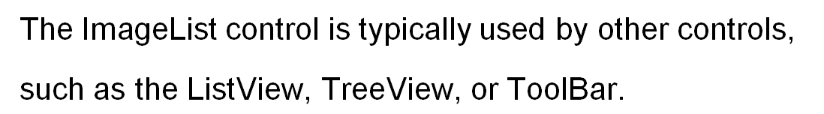
ImageList Control
  To manage a collection of Image objects (icons, bitmaps, or meta files)
Properties
Handle, ImageSize, TransparentColor, Images
Methods
Draw
Event
RecreateHandle
ImageCollection Class: Collection of Images
Properties: Count, Empty, Item
Methods: Add, Clear, Contains, IndexOf, Remove, RemoveAt
Default: 16 by 16.
Maximum size is 256 by 256.
Occurs when the Handle is recreated.
<number> of 17
Notes:
COMP2690 Windows Application Development with C#

Slide 4
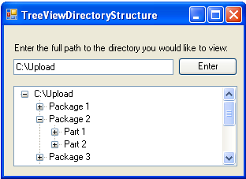
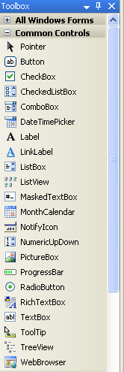
TreeView Control
  To display hierarchal information
  (For instance, file structure).
Root node
Child nodes of Package 2
TreeView Properties
CheckBoxes, ImageList, Nodes, SelectedNode
TreeView Event
AfterSelect
TreeNode Properties
Checked, FirstNode, LastNode, PrevNode, NextNode,
FullPath, SelectedImageIndex, Text, Nodes
TreeNode Methods
Collapse, Expand, ExpandAll, GetNodeCount
Holds a collection of TreeNode objects, each of
which has a Nodes property that can contain its
own TreeNodeCollection.
Methods: Add, Remove and Clear
True, False
<number> of 17
Notes:
COMP2690 Windows Application Development with C#

Slide 5
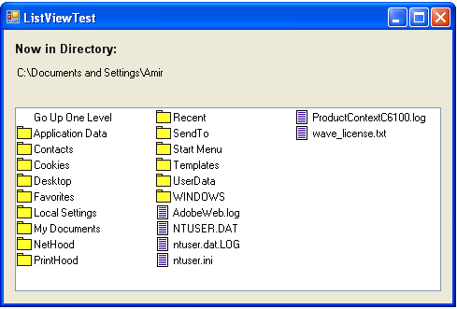
ListView Control
  To display a list of items with item text and, optionally, an icon.
Properties
Activation, CheckBoxes, LargeImageList, SmallImageList,
Items, MultiSelect, SelectedItems, View
Event
ItemActivate
OneClick, TwoClick (item changes color when selected), Standard (double-click, item does not change color)
1- LargeIcon: large icons displayed, items can be in multiple columns
2- SmallIcon: small icons displayed, items can be in multiple columns
3- List: small icons displayed, items appear in a single column
4- Details: like List, but multiple columns of information can be
displayed per item.
5- Tile: large icons displayed, information provided to right of icon
<number> of 17
Notes:
COMP2690 Windows Application Development with C#

Slide 6
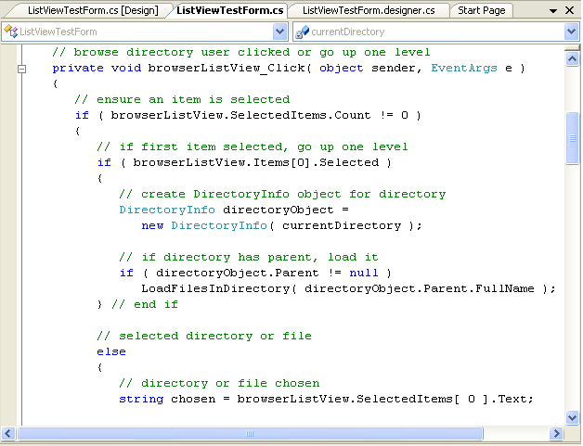
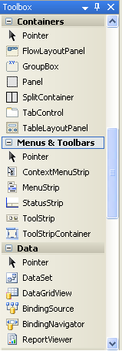
TabControl Control
  To create tabbed windows.
Tab Windows
Properties
ImageList, ItemSize, MultiLine, TabCount, TabPages,
SelectedIndex, SelectedTab, Alignment
Event
SelectedIndexChanged
Collection of TabPages
Top (the default), Bottom, Left, Right
Occurs when another TabPage is selected.
<number> of 17
Notes:
COMP2690 Windows Application Development with C#

Slide 7
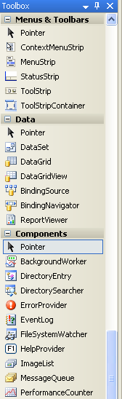
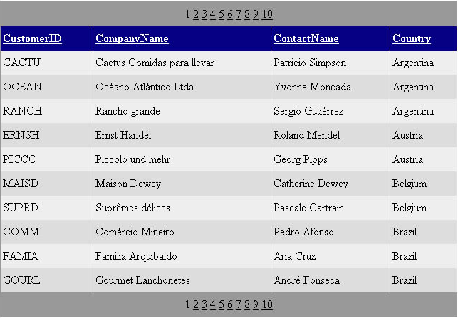
DataGrid Control
  To display a grid-like view of the contents of a data source. The
  DataGrid is a column-based control that supports various types of
  data-bound columns, including text, templated, and
  command columns.
Header
Item
Alternating Item
Pager
<number> of 17
Notes:
COMP2690 Windows Application Development with C#

Slide 8
DataGrid Control
Properties
DataSource, DataSourceID, DataMember, Columns, DateKeyField, DataKeys,
Items, SelectedItem, SelectedIndex, EditItemIndex, AutoGenerateColumns,
AllowSorting
AllowPaging, AllowCustomPaging, CurrentPageIndex, PageSize, PageCount,
PagerStyle
ShowHeader, ShowFooter, HeaderStyle, FooterStyle,
ItemStyle, SelectedItemStyle, EditItemStyle, AlternatingItemStyle, HorizontalAlign
GridLines, CellPadding, CellSpacing, Caption, CaptionAlign, BackImageUrl
<number> of 17
Notes:
COMP2690 Windows Application Development with C#

Slide 9
DataGrid Control
Events
EditCommand, CancelCommand, DeleteCommand, UpdateCommand
ItemCreated, ItemDataBound, ItemCommand, SelectedIndexChanged
SortCommand
PageIndexChanged
<number> of 17
Notes:
COMP2690 Windows Application Development with C#

Slide 10
Example
Add a Bound Column Object to a DataGrid
BoundColumn bc = new BoundColumn();
bc.DataField = “firstname”;
bc.HeaderText = “First Name”;
grid.Columns.Add(bc);
Paging Through the Data Source
Paging is a tough feature and a potential scalability killer.
protected void grid_PageIndexChanged (object sender, DataGridPageChangedEventArgs e)
{
grid.CurrentPageIndex = e.NewPageIndex;
// Bind to the control only the records that fit in the current page
grid.DataSource = GetRecordsInPage(grid.CurrentPageIndex);
}
Sort Columns of Data
Sorting is a potentially slow operation to accomplish and can have significant
repercussions on scalability.
protected void grid_SortCommand (object sender, DataGridSortCommandEventArgs e)
{
sqlDataSource1.SelectCommand += “ ORDER BY ” + e.SortExpression;
grid.DataSourceID = “sqlDataSource1”;
}
<number> of 17
Notes:
COMP2690 Windows Application Development with C#

Slide 11
DataGrid Control
Practical Tip
If you have an existing application to maintain, and you do not feel like leaping to
DataGridView, you already know all the details and techniques.
If you are building a new application and want to take advantage of grids, you do
not need to know about DataGrid controls and are better off focusing entirely on
DataGridView controls.
<number> of 17
Notes:
COMP2690 Windows Application Development with C#

Slide 12
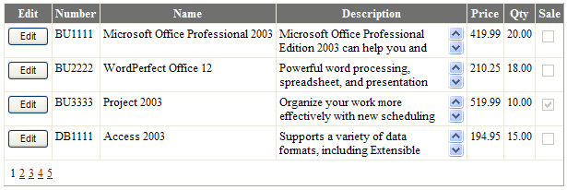
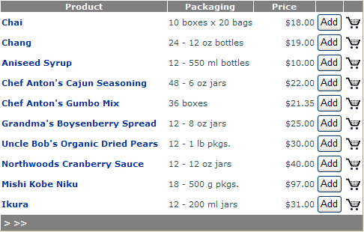
DataGridView Control
  To display a grid-like view of the contents of a data source. The most
  notable feature of DataGridView is its virtually codeless two-way data
  binding. It has the ability to define multiple primary key
  fields, new column types, and style options.
<number> of 17
Notes:
COMP2690 Windows Application Development with C#

Slide 13
DataGridView Control
Properties
Behavior Properties:
AllowPaging, AllowSorting, AutoGenerateColumns, AutoGenerateDeleteButton,
AutoGenerateEditButton, AutoGenerateSelectButton, DataSource, DataSourceID,
DataMember, EnableSortingAndPagingCallbacks, SortDirection, SortExpression
Style Properties:
HeaderStyle, FooterStyle, , RowStyle, AlternatingRowStyle,
EmptyDataRowStyle, SelectedRowStyle, EditRowStyle, PagerStyle
Appearance Properties:
ShowHeader, ShowFooter, PagerSettings, HorizontalAlign, EmptyDataText,
GridLines, CellPadding, CellSpacing, Caption, CaptionAlign, BackImageUrl
State Properties:
Columns, Rows, DataKeyNames, DataKeys, SelectedDataKey,
SelectedRow, SelectedIndex, EditIndex
PageCount, PageIndex, PageSize,
HeaderRow, FooterRow, TopPageRow, BottomPageRow
<number> of 17
Notes:
COMP2690 Windows Application Development with C#

Slide 14
GridView Control
Events
PageIndexChanging, PageIndexChanged,
RowCreated, RowCommand, RowEditing, RowCancelingEdit,
RowUpdating, RowUpdated, RowDeleting, RowDeleted,
RowDataBound,
SelectedIndexChanging, SelectedIndexChanged,
Sorting, Sorted
<number> of 17
Notes:
COMP2690 Windows Application Development with C#

Slide 15
GridView Control
Practical Tip
The DataGridView is the successor to the DataGrid control. DataGrid has one big
drawback: it requires you to write a lot of custom code, even to handle relatively
simple and common operations such as paging, sorting, editing, or deleting data.
The DataGridView control is designed to work around this limitation and make
two way databinding happen with as little code as possible.
<number> of 17
Notes:
COMP2690 Windows Application Development with C#

Slide 16
Homework 1: Using MenuStrip Control
Homework 2: Using StatusStrip Control
Homework 3: Using ToolStrip Control
Homework 4: Using FlowLayoutPanel Control
<number> of 17
Notes:
COMP2690 Windows Application Development with C#

